Slide 1
Session 2 Online contracting and validity issues
Eleftheria Tzamarou
Fall semester 2016

Slide 2
Delivery and risk
The trader is responsible for the condition of the goods from the time of dispatch until they are received by the recipient.
There is a default delivery period of 30 days during which the trader needs to deliver the goods to the recipient unless a longer period has been agreed.
If a particular date or period for delivery is agreed, goods should be delivered within that time

Slide 3
Delivery issues
Where the trader has failed to fulfil his obligation to deliver the goods at the time agreed upon with the consumer or within the time limit of 30 days, the consumer shall call upon him to make the delivery within an additional period of time appropriate to the circumstances.
If the trader fails to deliver the goods within that additional period of time, the consumer shall be entitled to terminate the contract and get a full refund.
Where delivery within the agreed delivery period is essential and the trader fails to deliver the goods at the time agreed, the consumer shall be entitled to terminate the contract immediately.

Slide 4
Consumer’s right to cancel
A “cooling off” period of 14 calendar days is provided during which a consumer can cancel a contract (i.e. a purchase) concluded online, by phone or mail order for any reason and without justification.
The right to cancel a purchase of goods starts the moment the consumer places the order and ends 14 days from the day after the consumer has received the goods.
The right to cancel a service bought at a distance starts the moment you concluded the contract (from the date the on-line order was placed) and lasts 14 days.

Slide 5
Consumer’s right to cancel
The trader must provide the consumer with a model withdrawal-cancellation form (available on the website or by email )
Consumer can withdraw from the contract by either using the model withdrawal form or making any other unequivocal statement. Not possible to withdraw from the contract by simply returning the goods without any explicit statement to this effect
The cooling-off period can be extended to a maximum of 12 months if the trader doesn’t give the consumer the information on their cancellation rights.

Slide 6
Model cancellation form
To [here the trader's name, geographical address and, where available, fax number and email address are to be inserted by the trader]:
I/We [*] hereby give notice that I/We [*] cancel my/our contract of sale of the following goods [*] / for the supply of the following service [*],
Ordered on [*] / received on [*],
Name of consumer(s),
Address of consumer(s),
Signature of consumer(s) (only if this form is notified on paper),
Date
[*] Delete as appropriate

Slide 7
Exemptions
The 14-day "cooling off" period does not apply to:
Contracts for transport and some leisure activities to be provided on a specific date such as plane and train tickets, concert tickets, hotel bookings, car rental reservations and catering services.
Perishable items such as foodstuff, drinks, flowers, newspapers intended for current consumption➔ likely to deteriorate and expire rapidly
Tailor-made or clearly personalized items – such as a tailor-made suit
sealed data carriers, such as DVDs, CDs or software which the consumer has unsealed upon receipt.
goods bought from a private individual rather than a company
urgent repairs and maintenance contracts – i.e. If you call a plumber to repair a leaking shower, you can't cancel the work once you have agreed on the price of the service.
The trader must inform the consumer that the cooling off period does not apply to the above products

Slide 8
Particular provisions for contracts of online digital content
Digital content means data which are produced and supplied in digital form, such as computer programs, apps, games, music, videos or texts, movies, irrespective of whether they are accessed through downloading or streaming
Retailers mustn’t supply digital content within the 14-day cancellation period, unless the consumer has given their express consent to this happening. The consumer must also acknowledge that once the download starts they will lose their right to cancel.
If a consumer doesn’t give their consent, the 14-day cooling-off period still applies but they won't be able to download their digital content until this period has ended.

Slide 9
Excessive call charges
Helpline phone charges in excess of the basic rate for calls by existing customers to the retailer or trader about products purchased are prohibited.
For example, if you are ringing to make a complaint, enquire about your order, or to cancel your order, retailers can't use premium rate numbers. They must provide a basic rate number for you to call.
If you do have to call a company on a surcharged number about goods or services you have bought, or have agreed to buy, you have the right to claim back the surcharge from the company.

Slide 10
Right to a refund-obligation to return goods
Retailers have an obligation to refund customers within 14 calendar days from receipt of cancellation.
Customers have an obligation to return items within 14 calendar days of such cancellation.
The direct cost of returning the goods is paid by the consumer if the trader has informed the consumer of this requirement. The consumer does not have to pay any other charges that he was not informed about.

Slide 11
Guarantees for faulty goods
Under EU rules, a trader must repair or replace free of charge, reduce the price or give the consumers a refund if goods they bought turn out to be faulty or do not look or work as advertised.
A consumer has a right to a minimum 2-year legal guarantee at no cost which starts as soon as he receives his goods. Second–hand goods bought from a trader are also covered by the minimum 2-year guarantee. However, goods bought from private individuals or at public auctions are not covered.
As a general rule, the consumer will only be able to ask for a partial or full refund when it is not possible to repair or replace the goods.
In the UK the Consumer Rights Act allows consumers to reject a faulty product and get a full refund as long as they reject it within a 30 day 'right to reject' period.
Any terms and conditions that say the consumer must cover the cost of returning an item wouldn’t apply where the goods being returned are faulty.
Defects in items that are specifically brought to the attention of the purchaser will not give grounds for a return

Slide 12
Contract formation under UK Law
Essential elements:
Agreement➔ exchange of offer and acceptance
Consideration
Intention to create legal relations (intention to enter into a legally binding agreement).
Legal capacity of the contracting parties.
Where the recipient of the service places his order through technological means, a service provider shall:
a. acknowledge receipt of the order to the recipient of the service without undue delay and by electronic means, and
b. make available to the recipient of the service appropriate, effective and accessible technical means allowing him to identify and correct input errors prior to the placing of the order

Slide 13
Invitation to treat
Under UK and US law, it is not the seller who makes an offer by displaying or advertising products on a website, but rather the customer who places an online order➔ An “order” can be a “contractual offer considered effective the moment when the party, to whom it is addressed, has access to it.
In the US, Uniform Commercial Code § 2-206(1)(b) provides that the placing of an order does not constitute acceptance, but instead “invites acceptance” and is therefore itself an offer.
The mere use of the word “offer” does not necessarily make a statement an offer. It often depends upon the interpretation of the language used and the surrounding circumstances.

Slide 14
Nature of order
Treatment of e-commerce websites as a binding offer or non-binding invitation to treat➔Legal consequences vary
When a website amounts to an invitation to treat➔ an order placed by the consumer is in fact an offer to purchase the goods/services and does not put any obligation on the website owner to provide the ordered goods/services. He retains freedom to contract.
When a website is deemed as an offer to consumers➔ an order placed by the consumer will constitute an acceptance and the communication of the order places a binding obligation on the website owner to provide consumers with the ordered goods/services.

Slide 15
Doctrine of consideration
Under English law, there must be a consideration for a contract to be binding – each party must obtain a benefit from the contract.
Something of value exchanged between the parties to the contract (normally goods or services by one party are exchanged for payment from the other party)
It is only where there is an element of mutuality about the exchange, with something being given by each side, that a promise to perform will be enforced.
Example: A promise to make a gift (donation) at some time in the future will only be enforceable in English law in absence of consideration if put into a special form, that is, a ‘deed’.

Slide 16
Contract formation under US law
It requires an offer and acceptance: meeting of the minds
Each party must offer something of value (known as consideration) to the other and there must be a meeting of the minds on what will be exchanged under the contract.
An offer to make a contract invites acceptance in any manner and by any medium reasonable under the circumstances
A confirmation would merely be repeating what the parties are already bound to perform and would have no legal effects under the U.S. law.

Slide 17
Receipt of an electronic communication under U.S. law
US Uniform Electronic Transaction Act (UETA)
It determines the time and place of dispatch and receipt of electronic communications
Time of dispatch➔ when an electronic record leaves an information system under the control of the sender.
An electronic record is considered received➔ when it enters the recipient's processing system in a readable form, even if no person is aware of its receipt.(i.e. recipient’s place of business or recipient’s residence).

Slide 18
Methods of online contracting
Exchange of e-mail➔ An offer sent from the offeror’s e-mail account to the offeree’s inbox, with the offeree’s consequent acceptance sent to the offeror’s mailbox, form the contract. Unless an email outlines very clear terms (e.g. delivery and payment dates) it will probably be seen as negotiations.
Text messages may form a binding agreement
Online transactions (website trading) and the automated transactions also known as web wrap or click-wrap agreements➔ related to the manner in which the consumer has notice of and assents to the terms of the agreement.

Slide 19
Click-wrap agreements
The vast majority of online agreements take the form of a “click-wrap agreement”.
Under a Click-wrap Agreement the website puts the terms of the agreement directly in front of the user and requires them to show that they affirmatively accept the terms by clicking a button that says for example “ I Agree” or “I Accept” on a web-page or pop-up screen.
Generally, the law does not require that the parties have actually read all of the terms in a contract for it to be effective. Therefore, clicking on a box that states "I agree" to certain terms can be enough.
Courts addressing “click-wrap” agreements have uniformly held them to be valid and enforceable

Slide 20
Best practices for enforceable click-wrap agreements
Presentation of the contract terms and general conditions to the user prior to any payment or other commitment or installation of software
Allow the user to easily read and navigate all of the terms (i.e. be in a normal, readable typeface with no scroll box)
Provide an opportunity to print, and/or save a copy of, the terms
Offer the user the option to decline as prominently and by the same method as the option to agree
Ensure the terms is easy to locate online after the user agrees.

Slide 21
Browse wrap agreements
A legal agreement that the user accepts indirectly by browsing an online site. Agreements which are formed not by clicking “I accept,” but through a user’s access or use of a website for which terms of use are in effect
Browse-wrap agreements are more likely to be rejected by courts because the fundamental element of assent is lacking.

Slide 22
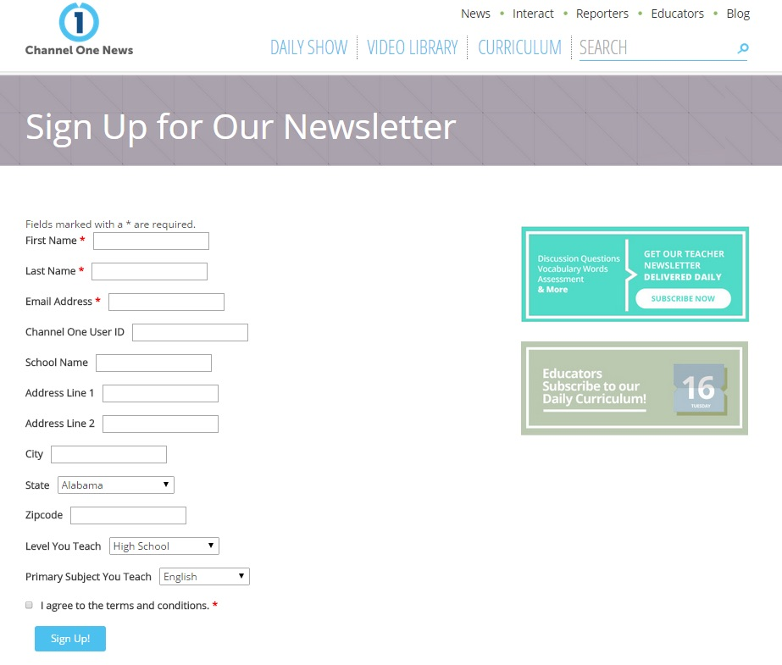
Example of Clickwrap agreement

Slide 23
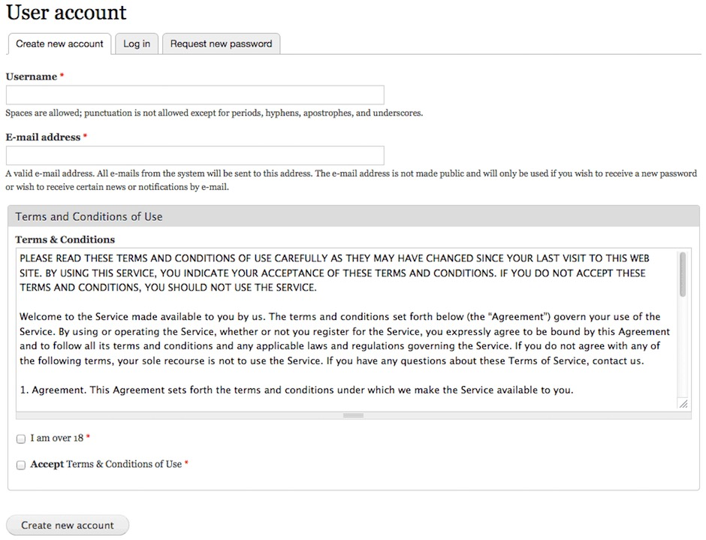
This clickwrap method is stronger, as it includes a tick box but also includes the Terms and Conditions right there for the user to read.
Example of clickwrap agreement

Slide 24
Commercial e-mail
A commercial email has as a primary purpose the commercial advertisement or promotion of a product or service.
Generally, commercial messages are exchanged through public electronic communication services such as the internet and mobile and landline telephony and via their accompanying networks.

Slide 25
Opt in regime
If you get an unsolicited advertisement in your e-mail inbox, it's spam.
Direct marketing communications may be sent only to recipients who have given their prior consent.
An "opt-in" generally refers to a tick box which, if filled in by the user, indicates positively that they would like to be contacted by a particular form of communication. Unless the user ticks the box then the company cannot use their details for the form of marketing listed.
refers to communications by automatic call machines, fax, calls, e-mail and text messaging

Slide 26
Exemption
A trader may send commercial emails for the purposes of direct marketing where:
(a) the contact details of the recipient of that electronic mail are obtained in the course of the sale of a product or service to that recipient;
(b) the direct marketing is in respect of that person's similar products and services only; and
(c) the recipient clearly and distinctly is given the opportunity to object, free of charge and in an easy manner, to such use of electronic contact details when they are collected and where he did not initially refuse the use of the details, at the time of each subsequent communication.

Slide 27
Opt out practice-Unsubscribing
Sending email for purposes of direct marketing by disguising or concealing the identity of the sender or without a valid address to which the recipient may send a request that such communications cease is prohibited.
Every message must include opt-out instructions or unsubscribe link➔ service providers undertaking unsolicited commercial communications by electronic mail should consult regularly and respect the opt-out registers in which natural persons not wishing to receive such commercial communications can register themselves.

Slide 28
Business e-mail
The same information disclosure requirements apply to business email as to physical business letters. Companies registered or operating in the EU need to state their company details on every electronic business communication.
Business email messages sent by a company should include:
The full name of the company and its legal form
The place of registration of the company
The registration number
The address of the registered office
The VAT number
A valid return address must be always provided.

Slide 29
Phishing and Spyware
Spyware is a type of malware (malicious software) installed on computers that collects information almost any type of data about users without their knowledge. The presence of spyware is typically hidden from the user and can be difficult to detect.
Phishing is attempting to acquire information (and sometimes, indirectly, money) such as usernames, passwords, and credit card details by masquerading as a trustworthy entity in an electronic communication. Phishing e-mails may contain links to websites that are infected with malware. Phishing is typically carried out by e-mail spoofing or instant messaging, and it often directs users to enter details on a fake website which looks almost identical to the legitimate one.
Fraudulent and criminal in nature practices which fall under criminal law.

Slide 30
US CAN-SPAM ACT
allows direct marketing email messages to be sent to anyone, without permission, until the recipient explicitly requests that they cease (opt-out).
consent to receive email can be considered implicit unless the recipient “opts out”
Following“Unsubscribe” instructions at the end of a commercial email, or clicking on a link are provided to facilitate opting out.

Slide 31
Electronic evidence

Slide 32
E-signature under U.S. law
As defined by the Uniform Electronic Transactions Act➔ "an electronic sound, symbol, or process attached to or logically associated with a record and executed or adopted by a person with the intent to sign the record.
A record is defined as information retrievable in electronic means.
An electronic record ➔ created, sent received or stored by electronic means.
Electronic Signatures in Global and National Commerce Act (E-SIGN 2000) gives e-signatures and e-documents legal force. For an e-signature to be enforceable, the contracting parties must have agreed to use electronic signatures.

Slide 33
E-signature Directive
“Electronic signature” is defined as
“data in electronic form which is attached to or logically associated with other electronic data and which is used by the signatory to sign”.

Slide 34
E-signatures-various forms
Electronic signatures deliver a way to sign documents in the online world, much like one signs a document with a pen in the offline world. They come in many forms, including:
Typewritten
Scanned
An electronic representation of a handwritten signature
A unique representation of characters
A digital representation of characteristics, for example, fingerprint or retina scan
A signature created by cryptographic means

Slide 35
Types of electronic signatures
Simple electronic signatures
Advanced electronic signatures
Qualified electronic signatures
Both advanced and qualified e-signatures use strong encryption methods.

Slide 36
Advanced Electronic Signature
An electronic signature which meets the following requirements:
it is uniquely linked to the signatory;
it is capable of identifying the signatory;
it is created using electronic signature creation data that the signatory can, with a high level of confidence, use under his sole control; and
it is linked to the data signed therewith in such a way that any subsequent change in the data is detectable.

Slide 37
Qualified Electronic Signature
An advanced electronic signature that is created by a qualified electronic signature creation device, and which is based on a qualified certificate for electronic signatures.
Under the eIDAS Regulation (EU) No 910/2014, a qualified certificate for electronic signature refers to “a certificate for electronic signatures, that is issued by a qualified trust service provider” and meets the requirements specified within the regulation.

Slide 38
E-signature and essential functions
They can have three essential functions when we consider on-line contracts:
To identify the person who has bought the product;
To indicate a personal involvement, or trustworthiness; and
To indicate an intention to be bound to the contract.

Slide 39
Admissibility of e-signatures
They satisfy the legal requirements of a signature in relation to data in electronic form in the same manner as a handwritten signature satisfies those requirements in relation to paper-based data and
All electronic signatures and verification services shall be admissible as evidence in legal proceedings.
The form or the type shall not be the only element to weigh when deciding on the effectiveness and admissibility of a signature

Slide 40

Domain names
A company identifies and distinguishes itself on the Internet by registering a domain name, usually a well-known name or a registered trademark.
An Internet address is composed of a "www" prefix (world wide web) and of a domain name. This domain name itself is composed of a chain of characters and of an extension (TLD - Top Level Domain). In the example above, the chosen TLD represents France : .fr.
Domain name registrations are allocated to persons by paying a nominal fee and filling out registration forms on a first come, first serve basis, irrespective of trademark rights in the name.

Slide 41
Cybersquatting and remedies
Cybersquatting is where a domain name is registered, sold or used with the intent of profiting from the goodwill from someone else’s trademark.
Internet Corporation for Assigned Names and Numbers(ICANN) which regulates the allocation of domain names introduced a private arbitral forum for the resolution of domain name disputes called Uniform Dispute Resolution Process➔ International arbitration forum.
At EU level, courts have addressed the problem of cybersquatting by applying traditional trademark infringement laws to claims brought by victims of cybersquatting

